Slide 1
Public Meeting Mill Creek GI Study
Jarrett Schuster, Environmental Resource Specialist
Environmental Compliance
Walla Walla District
Date: 12 Feb 2020
Notes:
I am going to talk with you a little bit tonight about Environmental Compliance and the National Environmental Policy Act, and how those tie into the Mill Creek GI study

Slide 2
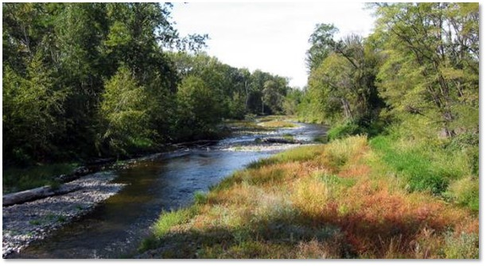
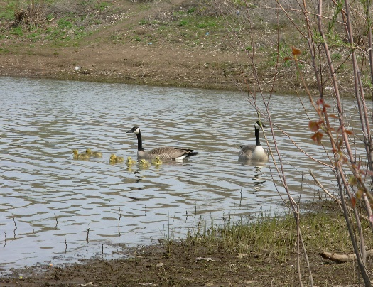
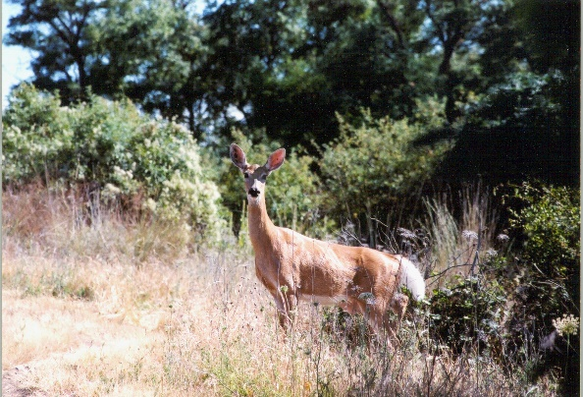
NATIONAL ENVIRONMENTAL POLICY ACT
(NEPA)
Good planning and decision making that considers the effects to the natural and
human environment.
Would the project proposed through this study significantly affect the quality of the environment?
Notes:
The National Environmental Policy Act or NEPA is a federal law used to determine if a federal action would have an impact to the environment.
NEPA is a planning and decision making tool that considers the effects of federal actions to the natural and human environment
The question we are trying to answer through the NEPA process is: Would the project proposed through this study significantly affect the quality of the environment?
Significance is measured in terms of the Context and Intensity of the action
For reference the federal actions for the Mill Creek GI are the partnership of the Corps with Walla Walla County and the spending of Federal funds

Slide 3
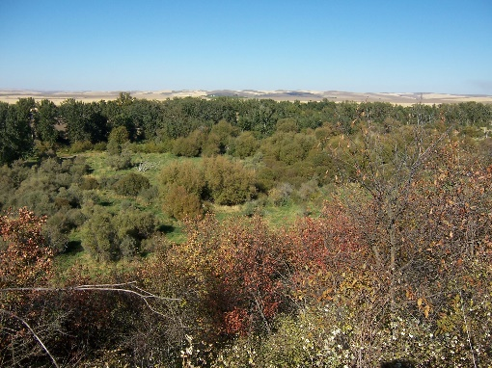
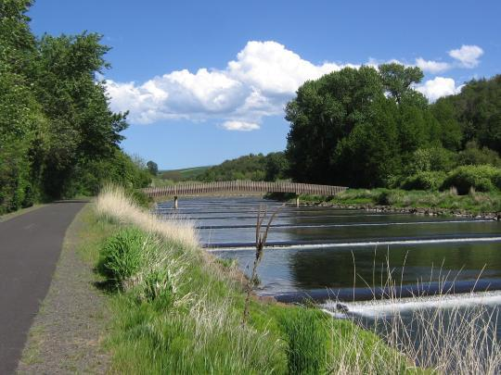
WHAT IS THE NEPA PROCESS?
Determine the Scope of the Project
Describe Purpose and Need
Describe Existing Environmental Conditions
Include Reasonable Range of Alternatives
Compare Alternatives to No Action
Evaluate Effects of Alternatives to Resources
Identify the Agency Preferred Plan (TSP)
Public Review
Decision Document Signed
Notes:
There are two Major components of NEPA:
1) Disclosure of Potential impacts from federal actions and
2) Public Involvement. Public involvement is through Scoping and Public Document Review and Comment Opportunities
First thing we do during the NEPA process is determine the scope of the project. The scope is determined in collaboration with the non-federal sponsor, various agencies, and the public
Then we determine the purpose and need of the study or the problem we are trying to solve.
next we describe the environmental conditions:
Physical (air, water, land)
Biological (fish, wildlife, vegetation)
Social (environmental justice, economics) and
Cultural (archaeological, historic properties)
Then we formulate a reasonable Range of Alternatives to address the purpose and need

Slide 4
HOW IS THE NEPA PROCESS DOCUMENTED?
The NEPA process will result in one of these documents:
Categorical Exclusion (Internal Memorandum For Record)
Environmental Assessment and Finding of No Significant Impact (FONSI), if applicable
Environmental Impact Statement and Record of Decision (ROD)
Types of Effects:
Direct Effects: Direct effects are caused by the action and occur at the same time and place
Indirect Effects: Indirect effects are caused by the action and are later in time or farther removed in distance,
but are still reasonably foreseeable
Cumulative Effects: Cumulative effect is the effect on the environment, which results from the incremental
impact of the action when added to other past, present, and reasonably foreseeable future actions
Notes:
Three levels of NEPA: Categorical exclusion, EA, EIS that end with different decision documents. The level of NEPA we do depends on the significance of potential impacts
To determine the significance of potential impacts we first determine the environmental baseline conditions and then determine the effects to the environmental resources if we did nothing. Then we assess the impacts of the proposed action to the environmental resources above the baseline conditions, again looking at the context and intensity of the impacts in the area.
For this study we are doing an Environmental Assessment and plan of signing a FONSI

Slide 5
HOW DOES NEPA RELATE TO OTHER ENVIRONMENTAL LAWS AND REGULATIONS?
NEPA
ESA
MBTA
NHPA
CAA
CWA
FWCA
MSA
RHA
Notes:
NEPA acts as an umbrella for compliance with other federal laws and regulations. A NEPA decision document (Catex, FONSI, ROD) will not be signed until compliance with all applicable laws and regulations is complete.
An example of some of the laws considered under NEPA include: the Magnuson–Stevens Fishery Conservation and Management Act

Slide 6
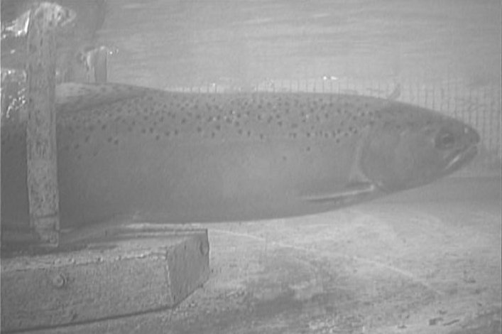
WHAT ABOUT ENVIRONMENTAL COMPLIANCE FOR
THE MILL CREEK FEASIBILITY STUDY?
Environmental Compliance ensures the construction of the Mill Creek Flood Risk Management Project resulting from this study would comply with all applicable environmental laws and regulations.
Environmental Opportunities for the Mill Creek GI Study
Potentially improve conditions for ESA-listed species
Potentially improve habitat conditions for wildlife
Environmental Constraints for the Mill Creek GI Study
Maintain fish passage
Adult steelhead passing from Yellowhawk Creek
into Mill Creek
Notes:
Environmental Compliance through NEPA ensures the construction of the Mill Creek Project resulting from this study would comply with all applicable environmental laws and regulations.
In addition to complying with laws and regulations, this study identifies two opportunities for potential environmental condition improvements: there may be opportunities to improve conditions for ESA-listed species and to improve habitat conditions for wildlife
There is also one environmental constraint for this study to ensure the conditions for fish passage are maintained

Slide 7
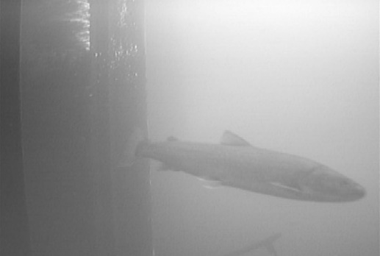
WHAT ABOUT ENVIRONMENTAL COMPLIANCE FOR
THE MILL CREEK FEASIBILITY STUDY?
Environmental Compliance progress to date:
Drafted an environmental assessment assessing the potential effects to 20 environmental resources
Produced a biological assessment and Fish and Wildlife Coordination Act “Functional Planning Aid Letter”
No mitigation measures determined up to this point
Adult bull trout passing through the Mill Creek
Diversion Dam
Notes:
Environmental Compliance progress to date
Mitigation measures may come through further consultation with the Services (USFWS and NMFS)

Slide 8
WHAT ARE THE NEXT STEPS?
Public review and comment period on the Draft Feasibility Report/Environmental Assessment
open until February 28, 2020
Finalize the Feasibility Report/Environmental Assessment taking public comments into consideration
Sign a Finding of No Significant Impact, if determined applicable (August 2021)

Slide 9
HOW TO COMMENT?
U.S. Army Corps of Engineers
Walla Walla District
CENWW-PPL-C
Mill Creek GI Study
201 North Third Avenue
Walla Walla, WA 99362-1876
OR
Submit Comments via E-mail:
NEPANWW@usace.army.mil

